Slide 1
Live collaborative projects
Applying theory to practice
Industry experience
Live projects
Real world clients
Relevant
Working with other professionals
Meaningful
Motivational
Cutting edge
Authentic
Innovative
Experiential learning
Opportunity recognition
Transformative
Transferable
Enterprising
Intrapreneurial
Free thinking
Fresh eyes
Creative
Problem solving
Research informed

Slide 2
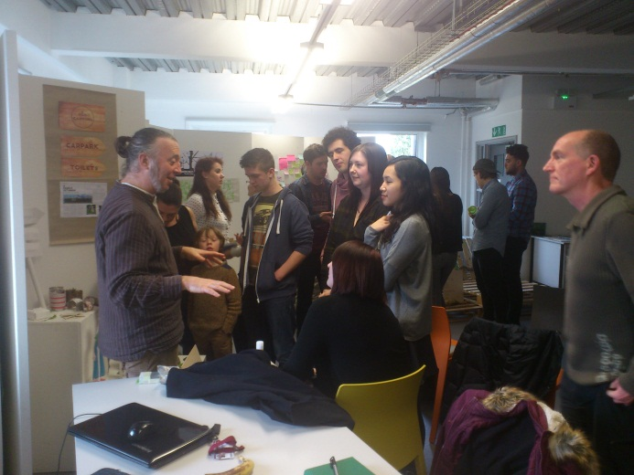
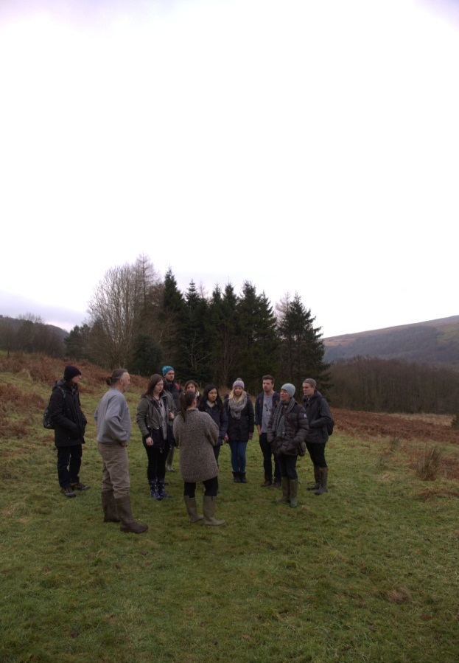
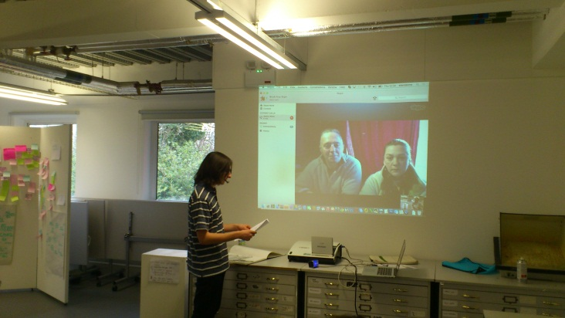
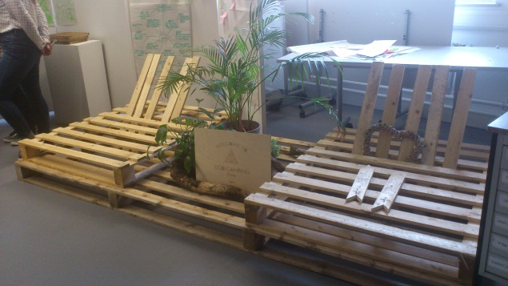
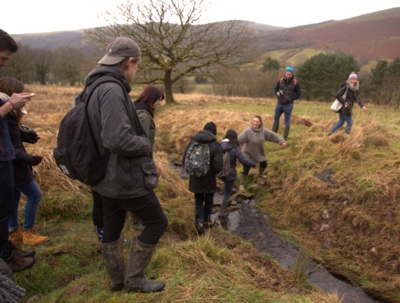
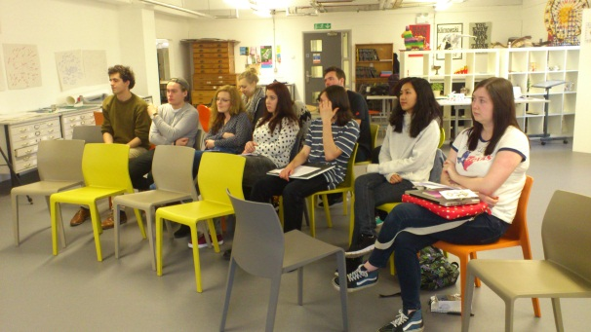
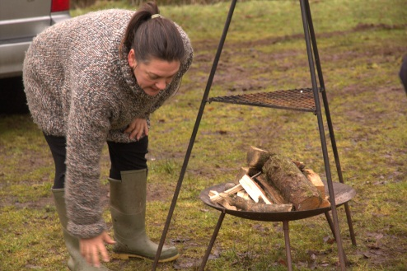
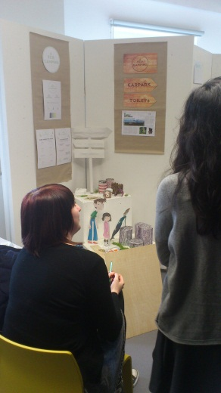
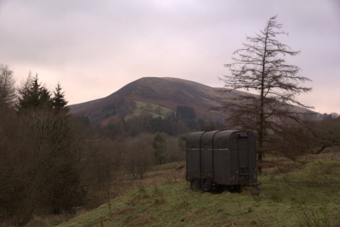
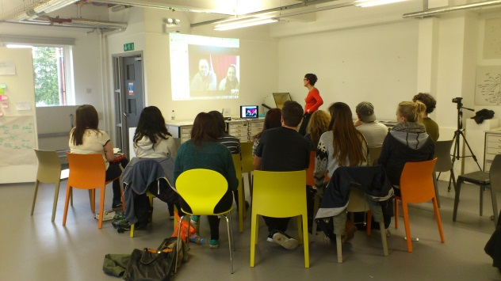
Agents for Change live project 2014 (EcoCamping Wales and CSAD students)
Site visit & client brief
Mid point student proposals
Final project presentations to clients

Slide 3
Student voices - reflecting on live projects
I think one of the biggest skills I’ve gained is innovation – it’s easy to have an idea, but it takes a lot of research to develop the idea into a working concept. I am now more knowledgeable in understanding what entrepreneurs are looking for – they are looking for researchers, people with an eye to capture the details of what is lacking in society. This project helped me identify solutions from a not so obvious point of view, thinking outside the box. As sustainability is such a growing industry, I feel that I now understand the importance of designing an environment that supports itself. – Howard Sinyangwe (Real World project 2014)
…I valued the opportunity to work on a real world project, with a real client and a real mentor. It has been an opportunity to build relationships and network with people I may never have met otherwise. – Emily Benwell (Real World project 2014)

Slide 4
Student placements
School of Management undergraduate students are each required to complete a 20 day placement in industry.
The aim of this scheme is to offer the student an opportunity to see how a business works, to put “theory into practice” and to develop transferable skills such as team working, communication and commercial awareness.
From your perspective the scheme is an opportunity to…
an opportunity to help in the development of the next generation of management graduates
benefit from having an enthusiastic undergraduate student with knowledge in relevant subject areas
engage an additional resource which your business can use, for example, to carry out an agreed project (perhaps one that your business might not otherwise have the resources or knowledge to complete)
carry out research with defined objectives

Slide 5
Student placement – business testimonials
“Student X was a delight to work with. Reliable, punctual, hard-working and very friendly, it was a pleasure to have her for the few months she was with us. We worked together developing a handbook for our volunteers and her contribution in helping me with this piece of work was considerable. I wouldn't have achieved anywhere near as much without her support" Sian Layton, Volunteer Co-ordinator, National Museum of Wales
"We were very happy to accommodate Hannah and she was a great asset to the team carrying out a piece of work that had been outstanding for a while She also fitted in well, showed good self- motivation and was able to work well with little supervision." Tracy Williams, Head of IT, United Welsh Housing Association

Slide 6
Student placements
Cardiff School of Management are looking to find placements for students who are completing undergraduate degrees in the following areas:
Accounting and Finance
Business Information Systems
Business and Management
Tourism
Hospitality
Events Management
International Business Management
Software Development
Economics
Marketing
If you think your business could support the scheme by offering one (or more) of our students a placement please speak to an event organiser

